Slide 1
Savings Management System

Slide 2
Contents
Login page
Administrator page
Control Panel
Account Management
Group Leader page
Home page
Group page
Contribution
Summary
Borrow
Member Page
Borrower Page

Slide 3
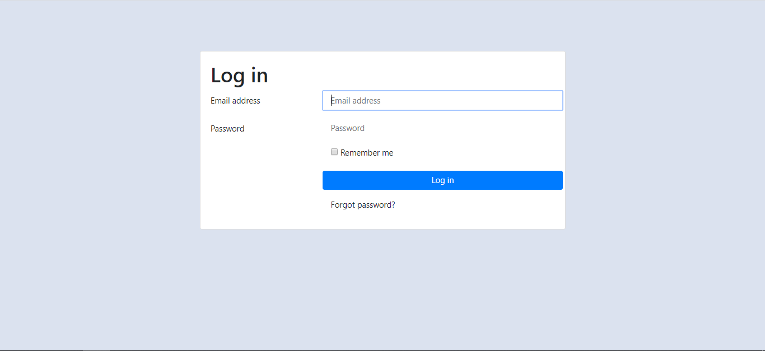
Login Page
Administrator account is initially created.

Slide 4
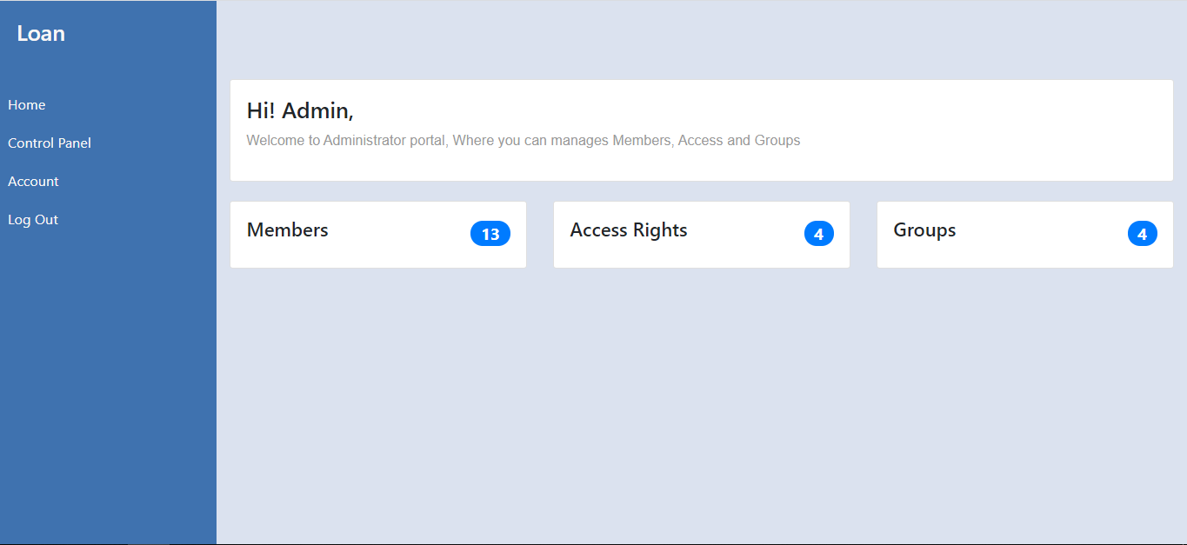
Administrator Page
This page consist of information of how many members registered, how many access rights defined and how many group/s created.

Slide 5
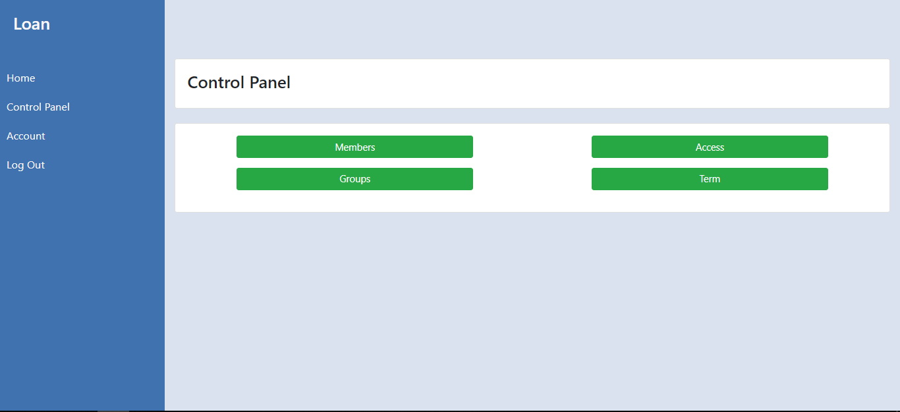
Administrator Page – Control Panel
This is where the administrator manage everything from members to access rights and groups and even the terms of the system

Slide 6
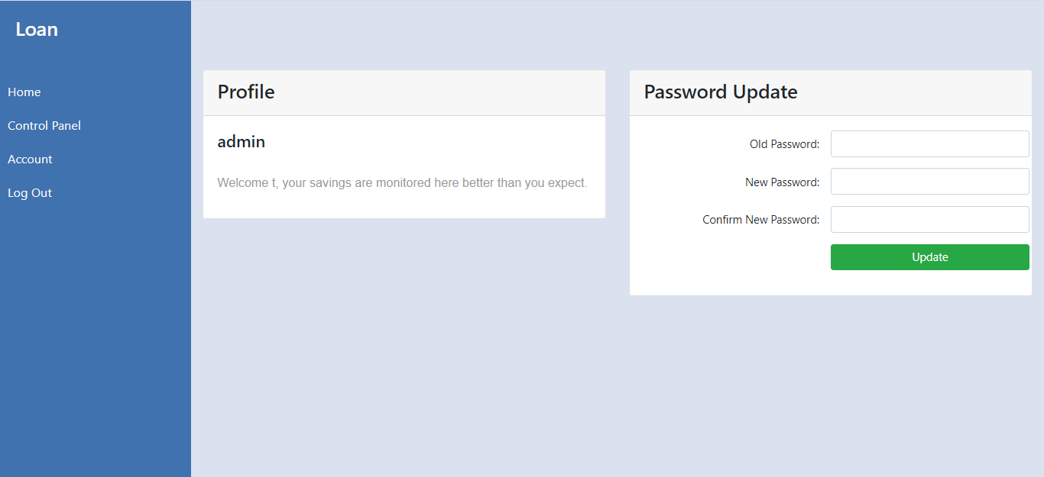
Administrator Page – Account
The page where every members change their password

Slide 7
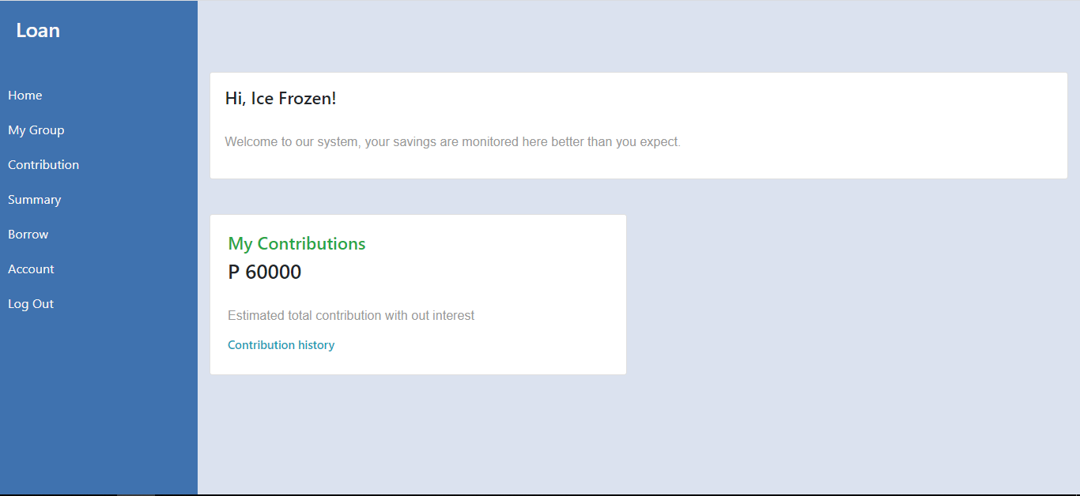
Group Leader page
This is the home page of the group leader. This is the standard home page of every account the side navigator is the only different from all of the account.

Slide 8
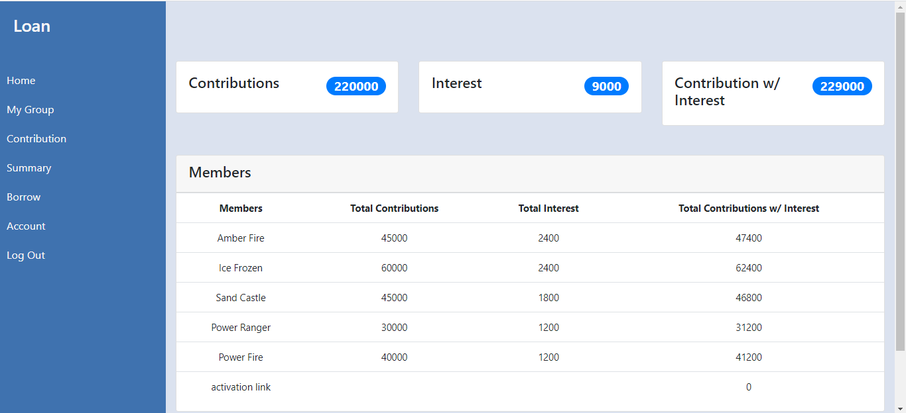
Group Leader – Group Page
The page is consist of members information such as contribution interest and earn interest
Only Group leader can see this page even admin cannot see this.

Slide 9
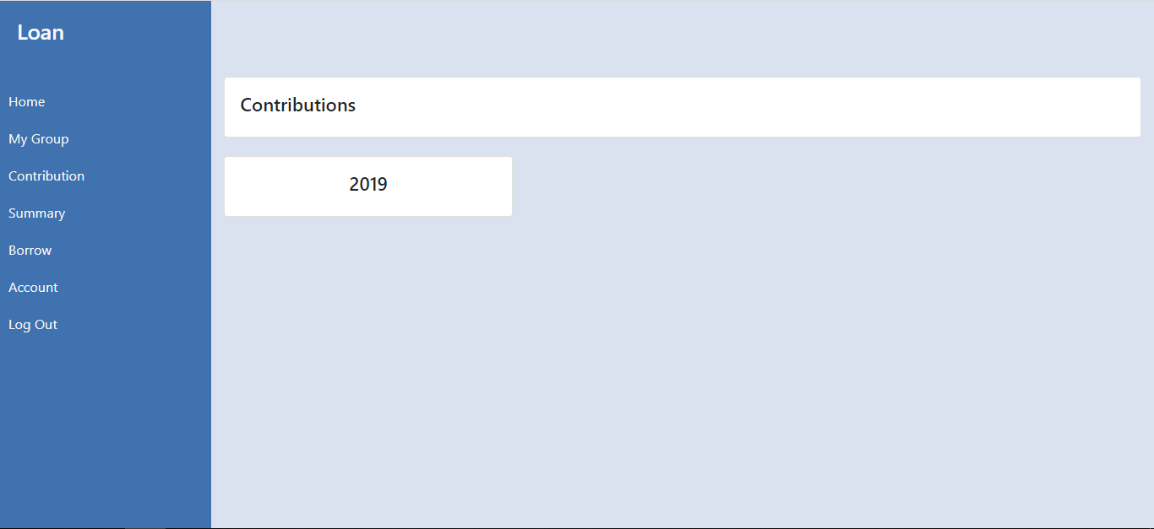
Group leader – Contribution Page
This page is where you can see all of the contribution of all of the members

Slide 10
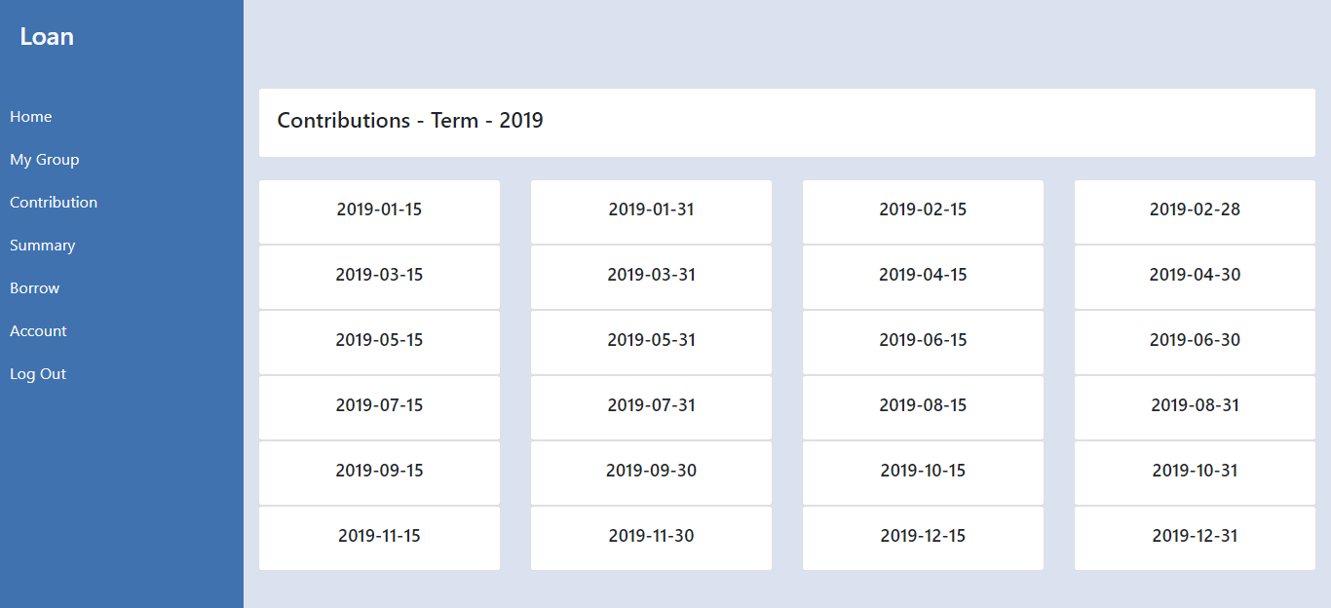
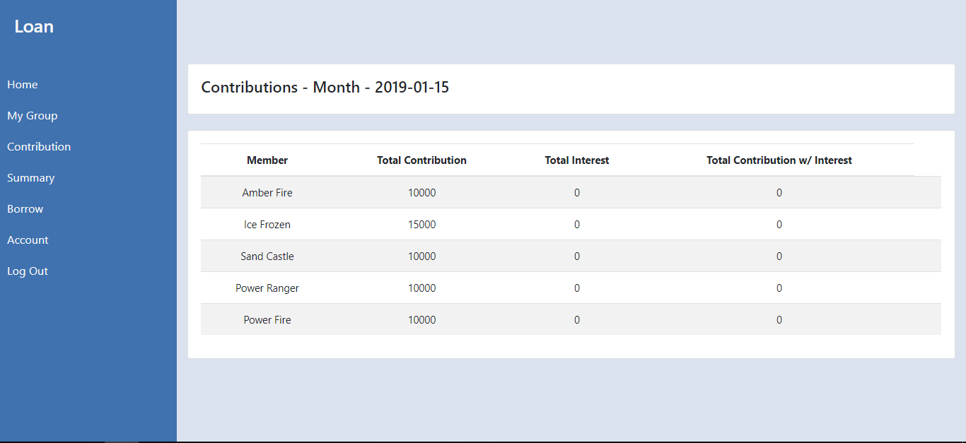

Slide 11

Group Leader – Summary Page
This page is where you can see all of the Summary

Slide 12
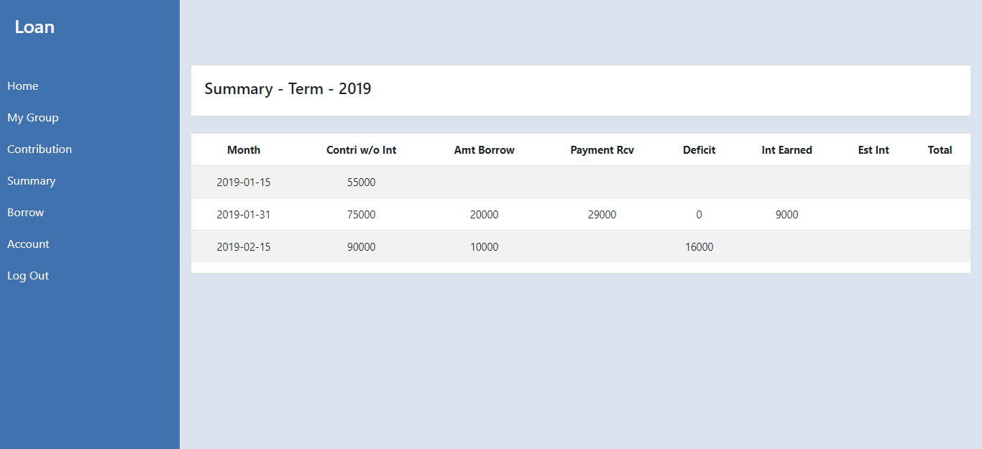

Slide 13
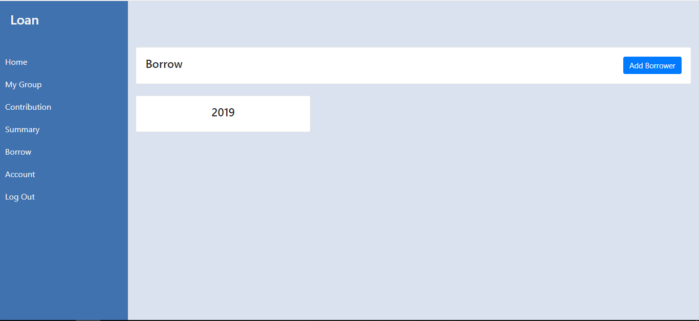
Group Leader – Borrow Page
This page is where you can see all of the Borrowed funds and also you can add borrower who is not member of any group that like to borrow.

Slide 14
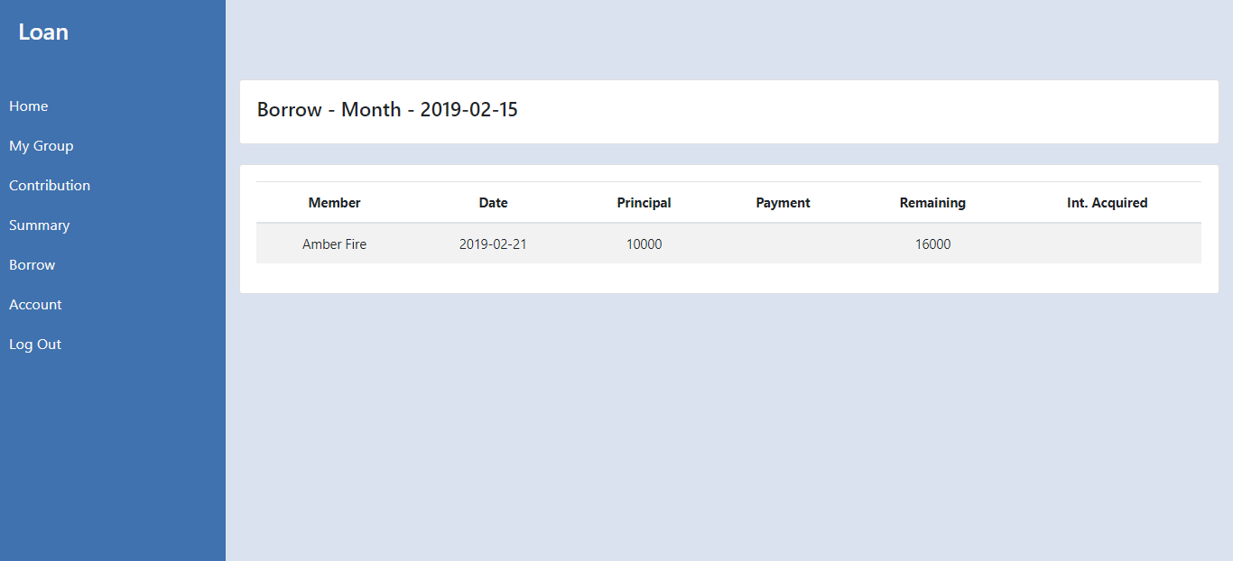

Slide 15
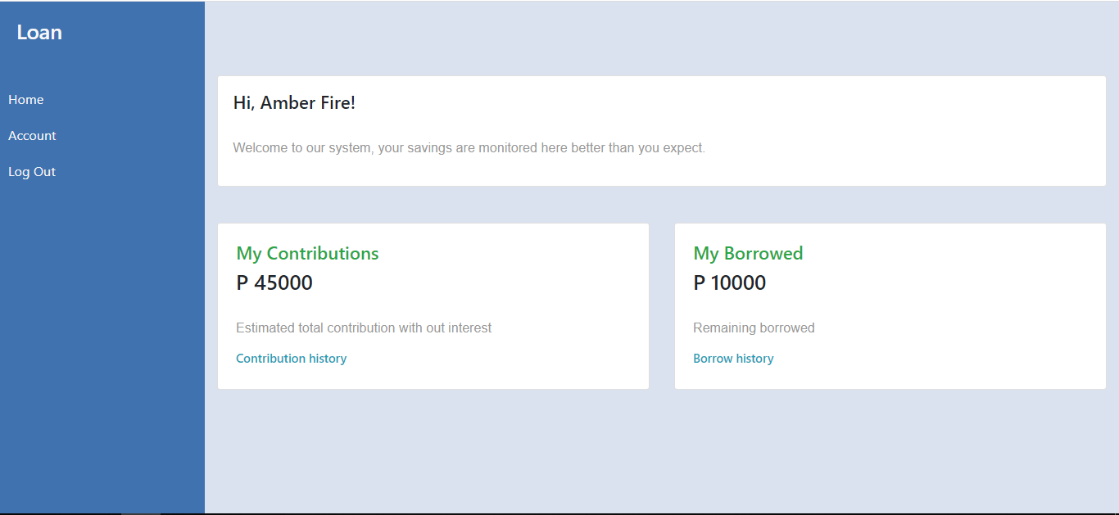
Member Page
This is the page of the member where belongs to a group.
Member can monitor his/her contribution and even the remaining payment for borrowed fund.

Slide 16
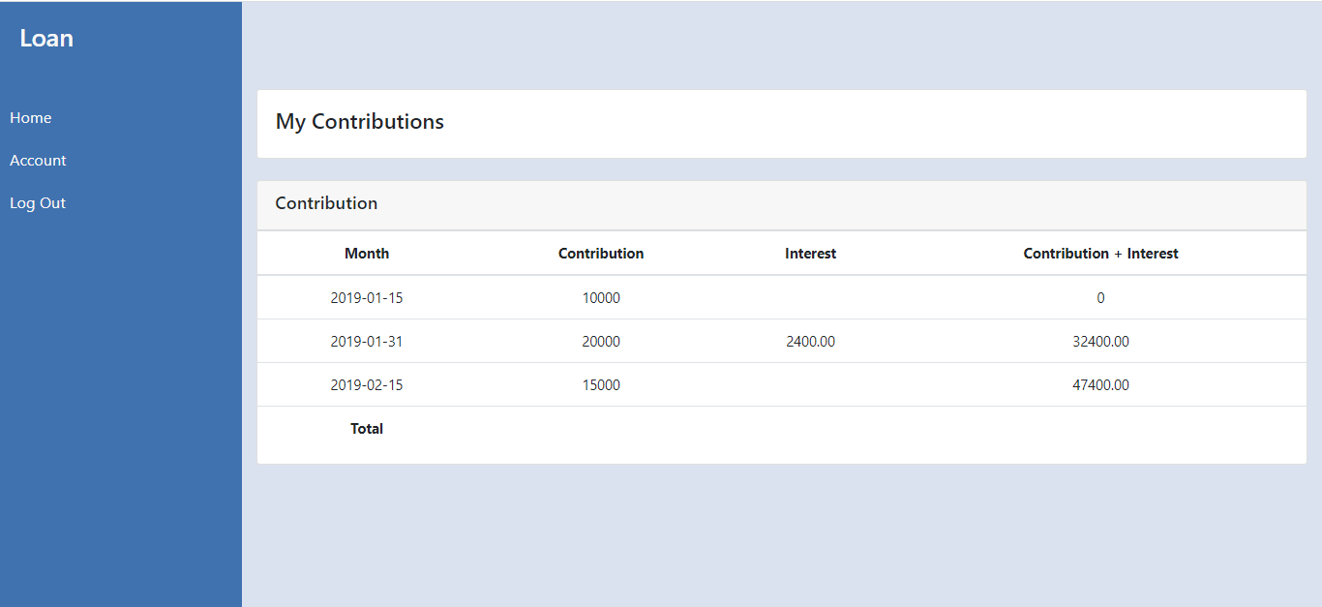
Member – Contribution Page
Page where member can see his/her contribution list

Slide 17
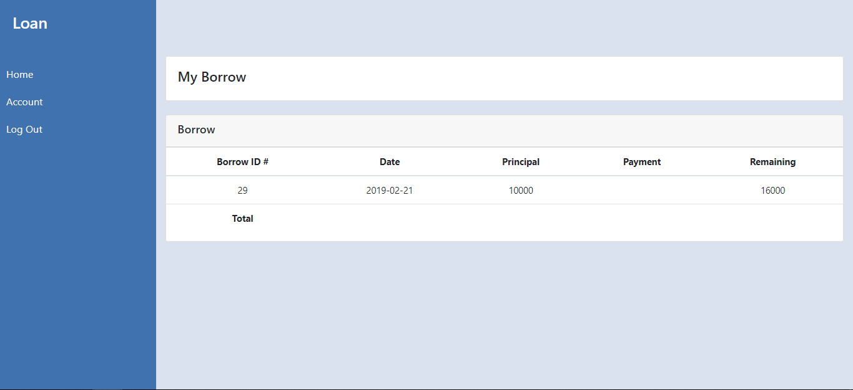
Member / Borrower – Borrow Page
Page to monitor members / borrow borrowed fund with borrow history

Slide 18
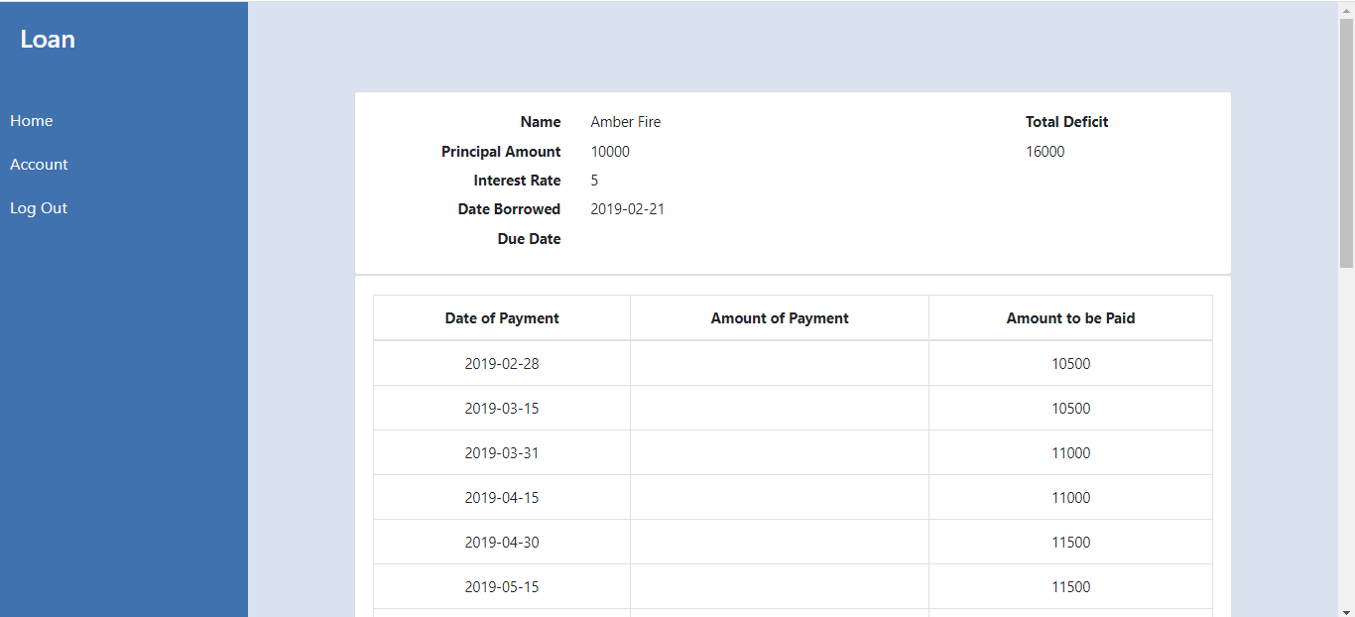
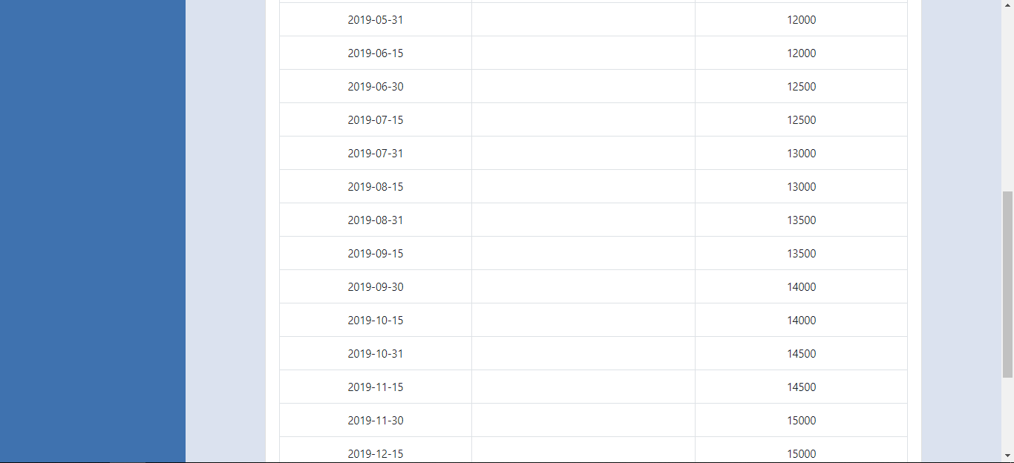

Slide 19
End
Version 1 – 02/21/2020

